Slide 1
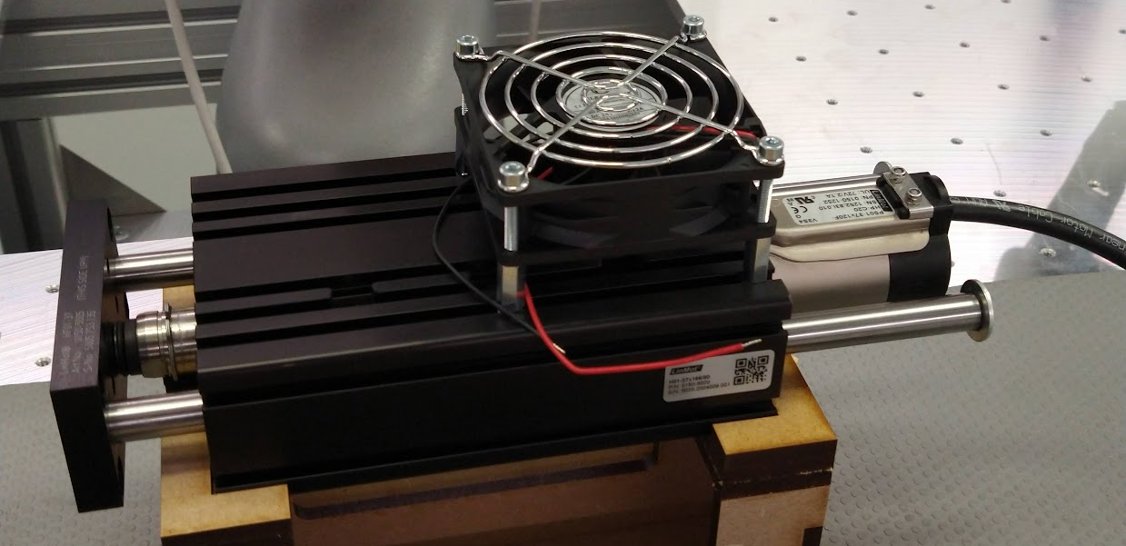
FM_SmartClamp_LinMot_EN
Bart Van Doninck
Assembly procedure of the linear motor of the Smart Clamp module

Slide 2


FM_SmartClamp_LinMot_EN
None
Magnetic field Magnets integrated in the sliders produce a strong magnetic field.
Contusions / Pinch point Sliders contain neodynium magnets and have a strong attractive force.

Slide 3
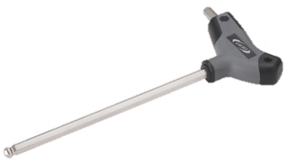

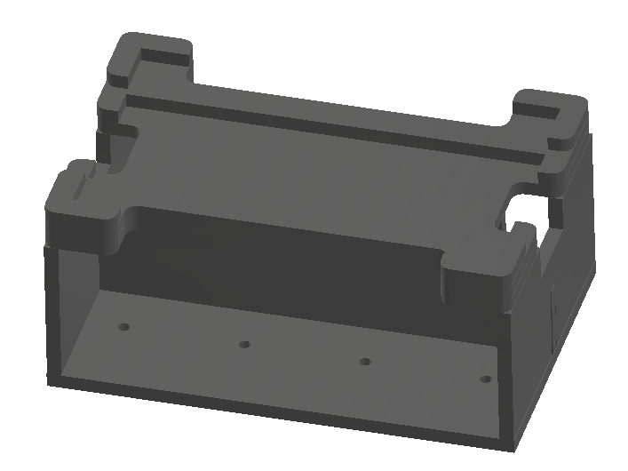
FM_SmartClamp_LinMot_EN
Hex key:
Size 3
Size 4
Size 5
Torque wrench
Fixture
1x Slider screw M8x25 (DIN 7984)
2x Spherical washer M8 (DIN 6319c)
2x Shaft screw M6x12 (ISO 4762)
1x Front plate (0150-5005)
2x Conical seat M8 (DIN 6319d)
1x Dished washer 16/8,2/0,9 (DIN2093A)
1x Slider (0150-1506)
2x Hardened steel shafts for ball bearings (0150- 5010)
3x Clamping screw M5x18 (ISO 4762)
3x Clamping cylinder (0150-5053)

Slide 4
FM_SmartClamp_LinMot_EN
1x Guide block with ball bearings (0150-5002)
1x Stator (0150-1252)
2x Washer M6 20/1,5
2x Shaft screw M6x12 (ISO 7380)
1x Brake hole cap (0160-0727)
1x Cooling fan 80x80mm
4x Square nut M4 (DIN 562)
4x Hexagonal spacer M4x16
4x Screw M4x30 (ISO 4762)
1x Protective grid

Slide 5
Step 1:
Make sure the assembly kit is available on the work table

Slide 6
Step 2
Grab the black guide block from the table and position it in the fixture with the T-slots upwards and the 3 holes towards you.

Slide 7
Step 3
Grab the stator from the kit.

Slide 8
Step 4
Slide the stator carefully in the housing from the right side.

Slide 9
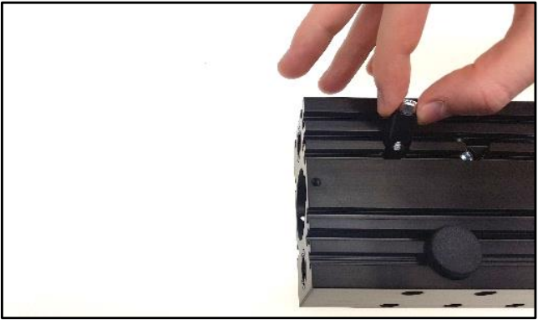
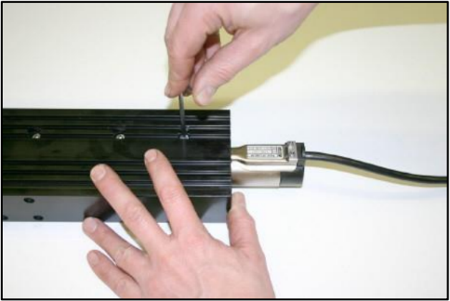
Step 5
Fix the stator in the housing:
Grab three clamping cylinders from the container on the table
Grab three clamping screws M5x18
Insert the clamping cylinders completely and put a screw in each of them.

Slide 10
Step 6
Grab the brake hole cap from the container and push it in the hole on the guide block.

Slide 11
Step 7
Assemble the slider:
Grab the tube with the slider from the kit.
Open the tube and carefully extract the slider rod. It is highly magnetic, so grasp it firmly.
Insert the slider into the stator from the left side. You’ll notice some resistance resulting from the magnetic effects.
Put the tube back in the kit.

Slide 12
Step 8
Insert the hardened steel shafts in the guide block from the right side.

Slide 13
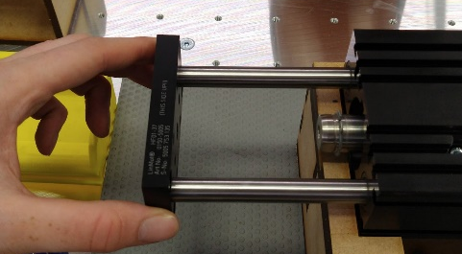
Step 9
Put the front plate against the two shafts.
Make sure ‘This side up’ is visible after mounting. The text should be oriented towards the housing.
Fix the front plate to the shafts by using the two shaft screws M6x12 and the hex key (size 5).

Slide 14
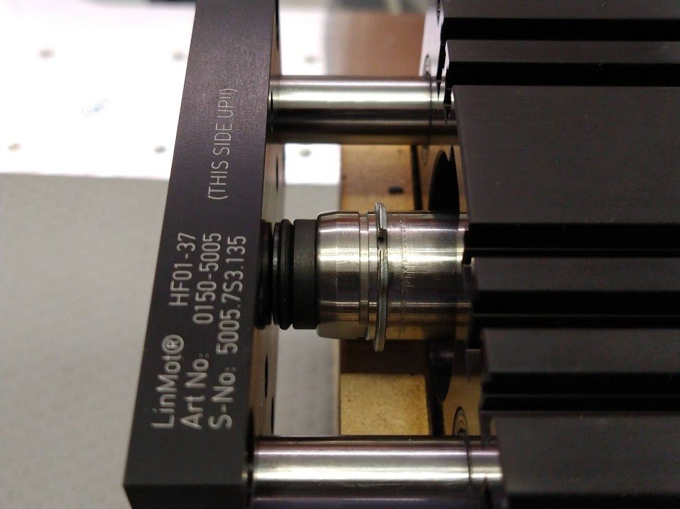
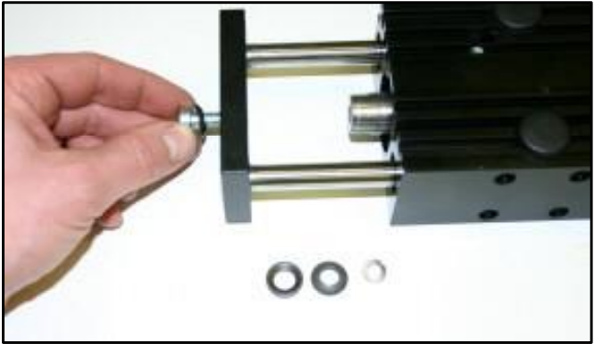
Step 10
Prepare the slider screw
Grab the slider screw M8x25 from the container.
Grab 2 spherical washers, 1 conical seat and 1 dished washer from the container.
Place the spherical washer on the slider screw and insert it into the front plate. The conical seat is milled into the front plate.

Slide 15
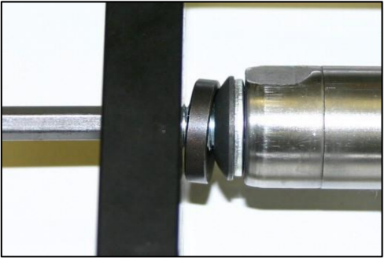
Step 11
Attach the front plate to the slider:
Place the conical seat, the spherical washer and the dished washer on the other side of the front plate onto the slider screw
Screw the bolt into the slider rod end. Use a hex key (size 5) for this.
Torque at max 6Nm.

Slide 16
Step 12
Grab 4 square nuts M4 and 4 hexagonal spacers M4x16 from the containers on the table.

Slide 17
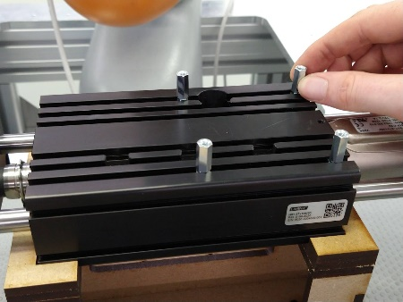
Step 13
Assemble spacers:
Slide the 4 square nuts into the T-slots on the guide block in the correct positions.
Screw the 4 hexagonal spacers onto the square nuts.

Slide 18
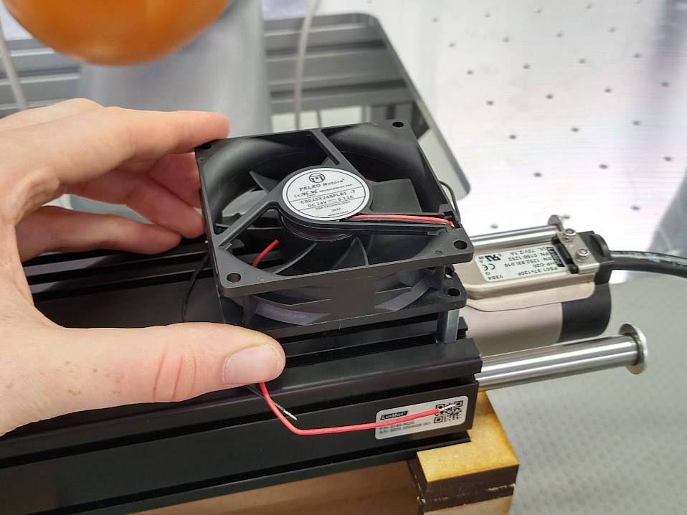
Step 14
Put the cooling fan on top of the spacers and adjust the spacer position if necessary.

Slide 19
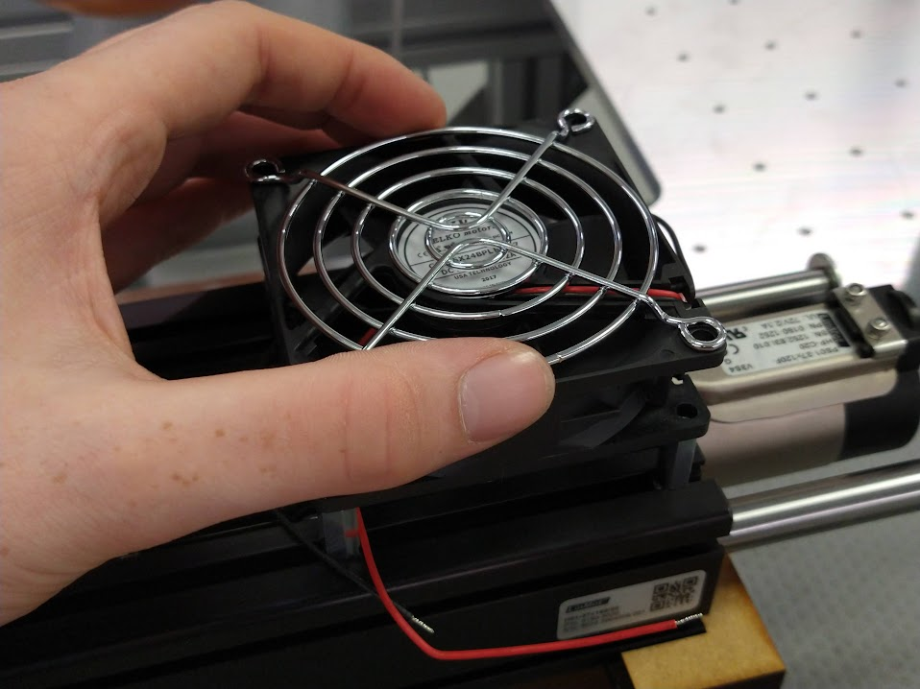
Step 15
Put the grid on top of the cooling fan.

Slide 20
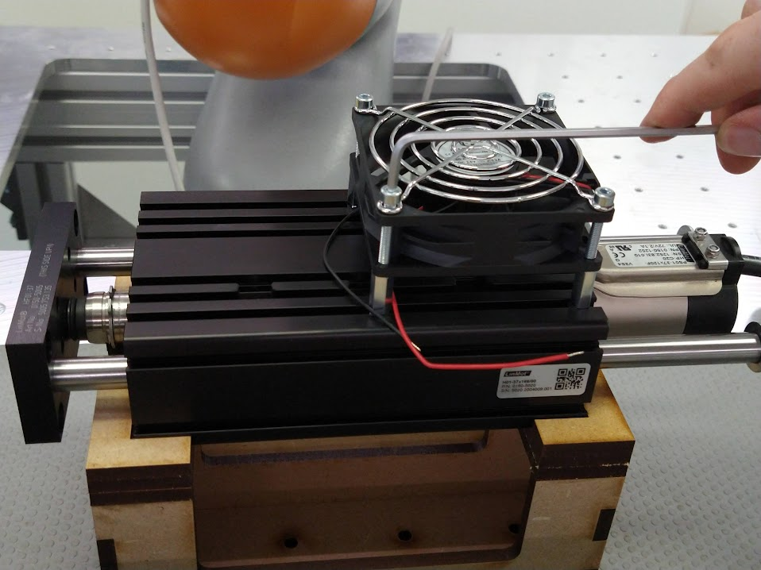
Step 16
Assemble cooling fan
Grab 4 screws M4x30 from the container on the table
Fix the 4 screws using the hex key (size 5)

Slide 21

Step 17
The assembly is finished.

